Slide 1


Data Structures
Week5_Lecture1 (part1)
Arrays Sorting
Subhan Ullah, PhD
subhan.ullah@nu.edu.pk
BS(Cybersecurity) Fall-2023

Slide 2
Agenda
Recap
Lists (Roadmap)
Linked List
Circular Linked List

Slide 3
Circular Linked List

Slide 4
Circular Linked List
A linked list in which the last node points to the first node
A0
A1
A2
A3
head
Simple (singly) linked list
A0
A1
A2
A3
head
Circular linked list

Slide 5
Advantages of Circular Linked List
Whole list can be traversed by starting from any point
Any node can be starting point
What is the stopping condition?
Fewer special cases to consider during implementation
All nodes have a node before and after them
Used in the implementation of other data structures
Circular linked lists are used to create circular queues
Circular doubly linked lists are used for implementing Fibonacci heaps

Slide 6
Disadvantages of Circular Linked List
Finding end of list and loop control is harder
No NULL to mark beginning and end

Slide 7
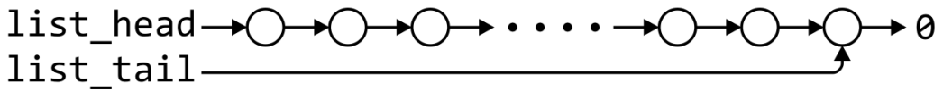
Time complexity of singly linked list
 | Front/1st node | k^{th} node | Back/n^{th} node
Find | Θ(1) | Ο(n)* | Θ(1)
Insert Before | Θ(1) | Ο(n)* | Θ(n)
Insert After | Θ(1) | Θ(1)* | Θ(1)
Replace | Θ(1) | Θ(1)* | Θ(1)
Erase | Θ(1) | Ο(n)* | Θ(n)
Next | Θ(1) | Θ(1)* | n/a
Previous | n/a | Ο(n)* | Θ(n)
* These assume we have already accessed the k^{th} entry—an O(n) operation

Slide 8
Time complexity of singly linked list
 | Front/1st node | k^{th} node | Back/n^{th} node
Find | Θ(1) | Ο(n)* | Θ(1)
Insert Before | Θ(1) | Θ(1)* | Θ(1)
Insert After | Θ(1) | Θ(1)* | Θ(1)
Replace | Θ(1) | Θ(1)* | Θ(1)
Erase | Θ(1) | Θ(1)* | Θ(n)
Next | Θ(1) | Θ(1)* | n/a
Previous | n/a | Ο(n)* | Θ(n)
By replacing the value in the node in question, we can speed things up
– useful for interviews

Slide 9
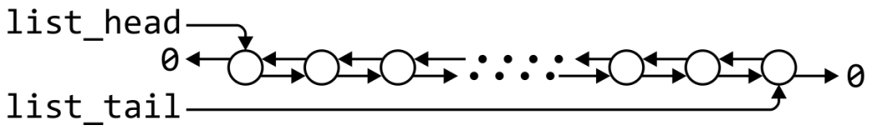
Doubly linked list
 | Front/1st node | k^{th} node | Back/n^{th} node
Find | Θ(1) | Ο(n)* | Θ(1)
Insert Before | Θ(1) | Θ(1)* | Θ(1)
Insert After | Θ(1) | Θ(1)* | Θ(1)
Replace | Θ(1) | Θ(1)* | Θ(1)
Erase | Θ(1) | Θ(1)* | Θ(1)
Next | Θ(1) | Θ(1)* | n/a
Previous | n/a | Θ(1)* | Θ(1)
* These assume we have already accessed the k^{th} entry—an O(n) operation

Slide 10
Doubly Linked list
Accessing the k^{th} entry is O(n)
 | k^{th} node
Insert Before | Θ(1)
Insert After | Θ(1)
Replace | Θ(1)
Erase | Θ(1)
Next | Θ(1)
Previous | Θ(1)

Slide 11
Doubly linked list
Other operations on linked lists include:
Allocation and deallocating the memory requires Θ(n) time
Concatenating two linked lists can be done in Θ(1)
This requires a tail pointer

Slide 12
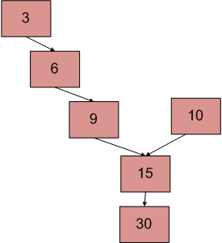
Practice Problems
Write a recursive function to print a linked list in reverse order.
Perform a circular right shift on a linked list by a specified number of positions. If the position parameter is 1, and the list is 1,2,3,4,5; the output should be 5,1,2,3,4.
There are two singly linked lists in a system. By some programming error, the end node of one of the linked lists got linked to the second list, forming an inverted Y-shaped list. Write a program to get the point where two linked lists merge.

Slide 13
Solution to Problem 1
void printReverse(Node* head)
{
// Base case
if (head == NULL)
return;
// print the list after head node
printReverse(head->next);
// After everything else is printed, print head
cout << head->data << " ";
}

Slide 14
Solution to Problem 2
Solution approach:
Run a loop from zero to “positions”. In the loop, do the following:
Traverse the list till the last node. Use two pointers: one to store the address of the last node and other for the address of the second last node. After the end of loop, make the second last node as the last node and the last node as the head node.
Essentially what you are doing is making a copy of the last node, deleting the last node and inserting it in position zero. You do this in a loop up to number of positions.

Slide 15
Solution to Problem 3
Use 2 nested for loops. The outer loop will be for each node of the 1st list and the inner loop will be for the 2nd list. In the inner loop, check if any of the nodes of the 2nd list is the same as the current node of the first linked list. The time complexity of this method will be O(M * N) where m and n are the numbers of nodes in two lists.
Node* getIntesectionNode(Node* head1, Node* head2)
{
while (head2) {
Node* temp = head1;
while (temp) {
// if both Nodes are same
if (temp == head2)
return head2;
temp = temp->next;
}
head2 = head2->next;
}
// intersection is not present between the lists
return NULL;
}

Slide 16


